Slide 1
Audio Unit Extensions

Slide 2
Overview
Overview by Mitch Gallagher
Writer of music engineering texts and magazine articles
e.g., “Acoutic Design for the Home Studio”
https://www.youtube.com/watch?v=eiMjTqN_jOs

Slide 3
Current Status
June 2015 – announced at WWDC
September 2015 – SDK released to iOS Developers
January 2016 – GarageBand 2.1 ($5) supports AU extensions
Other hosts:
MultiTrackStudio for iPad ($30)
Same DAW shown in video
AUM Audio Mixer ($20)
Simple 4-track style recorder/mixer
Plugins in the App store:
iSEM by Arturia ($10)
Shown in video
Blamsoft effects bundle

Slide 4
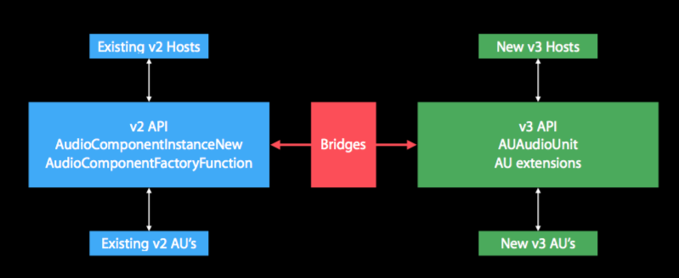
Overview
Fully hosted plugin model in OSX or iOS
Pot extensions on the App Store
New AUv3 API (good or bad, I don’t know, Apple calls it “modern” and “compatible”
Based on new Objective-C class “AUAudioUnit”
Minor source changes
compatible

Slide 5
What is an App Extension
Different life cycle
(1) User selects extension based on description
(2) Host sets up communication by launching the “principal class” and extension provides view within the context of the host app
(4) User dismisses extension, and host tears down the view and user returns to previous context

Slide 6
Setting up an .AppEx
AudioComponentDescription - These uniquely identify an Audio Unit in the system
component type – a unique 4-byte identifying code
Subtype – a 4-byte code to indicate the purpose
and manufacturer – unique vendor identifier, registered with Apple
Testing/debugging an extension
Can be very tedious, if not impossible via host app!
Create a “containing App” to load a framework in place of the App Extension
no XPC (cross-process communication)
Code re-use
Make actual extension as a bare bones wrapper

Slide 7
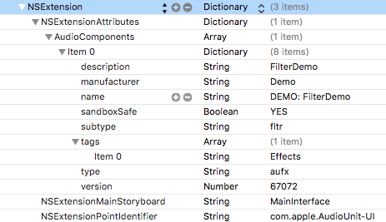
Setting up an .Appex (cont’d)
Info.plist
com.apple.AudioUnit-UI – type of extension
MainStoryboard – open this on launch
AudioComponents – descriptions to be registered

Slide 8
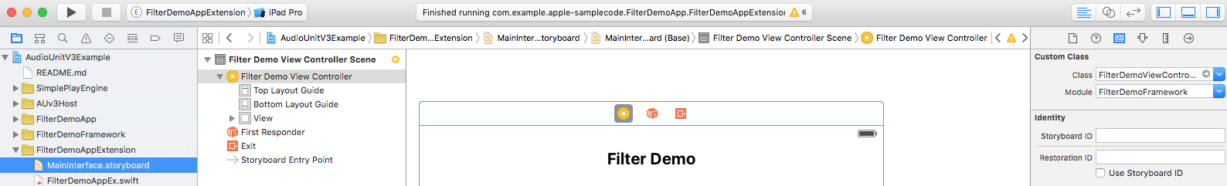
Setting up an .Appex (cont’d - 2)
Inside our App Extension’s MainInterface
In its View Controller
Be sure to specify:
The custom class (your VC that handles your AppEx’s xib)

Slide 9
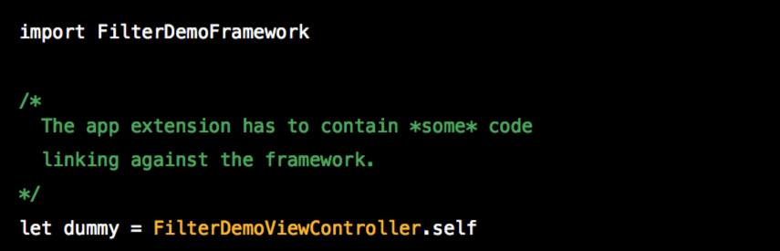
Setting up an .Appex (cont’d - 3)
Our entire extension is simply

Slide 10
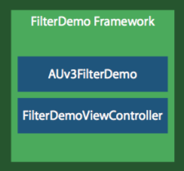
Setting up an .Appex (cont’d - 4)
Both the containing App and the Extension pull the framework
Re-use these for all of your filters
Containing App
Simplified host
Extension
The main filter code
Trivial wrapper

Slide 11
The “Principal Class”
Framework:FilterDemoViewController
Whenever the extension is loaded, this class is created
Creates AUAudioUnit subclass
Creates and manages custom view (xib if you prefer)
Must derive from AUViewController
Must implement AUAudioUnitFactory

Slide 12
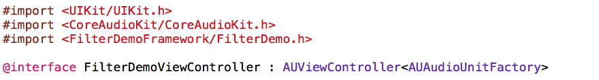
The “Principal Class” (cont’d)
AUViewController
Basically just a UIViewController
AUAudioUnitFactory
Has one method: createAudioUnitWithComponent

Slide 13
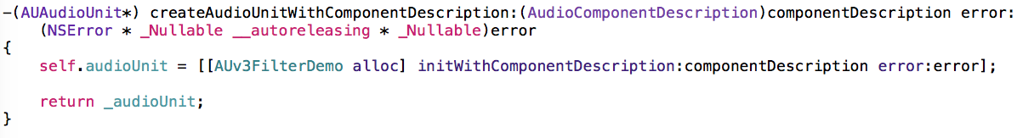
The AU Audio Unit Subclass
@interface AUv3FilterDemo{
// This is a subclass of AUAudioUnit
FilterDSPKernel kernel;
// This is your filter’s main processing class
BufferedInputBus inputBus;
AUAudioUnitBus *outputBus;
// These are where we receive and place data
AUAudioUnitBusArray *inBusArray;
AUAudioUnitBusArray *outBusArray;
// These wrap busses
AUParamterTree *paramTree;
}

Slide 14
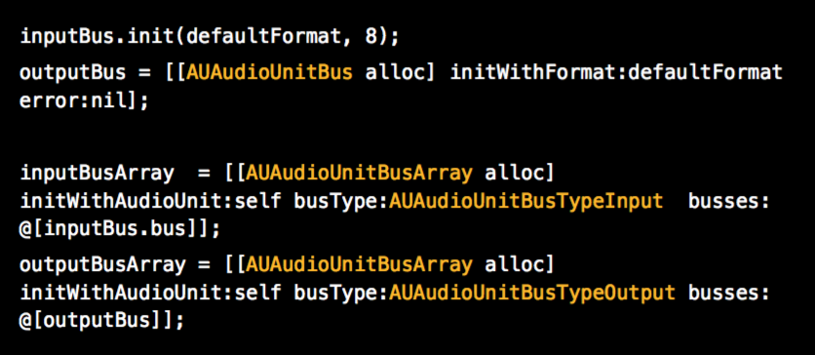
The AU Audio Unit Subclass (cont’d)

Slide 15
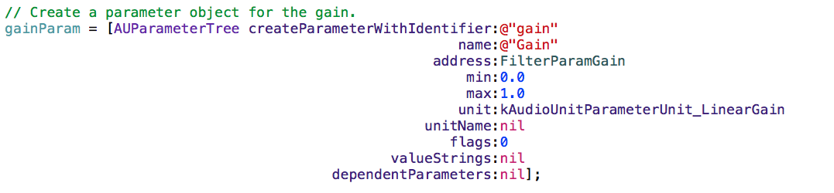
Creating Parameters
The parameter is a “middle man” between your implementation and the host
Must assign an identifier, name, address (an enum representing the “index” of this parameter), min value, max value, and value type (Hz, dB, linear, etc.)

Slide 16
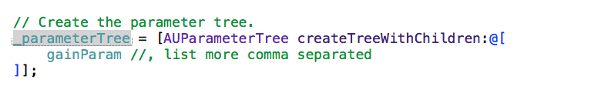
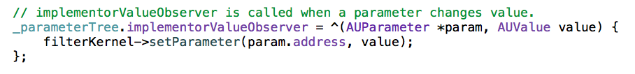
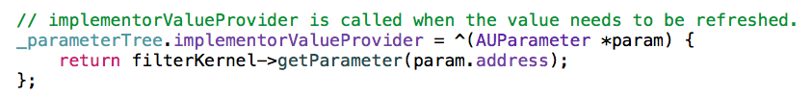
Creating the Parameter tree
The parameter tree connects to the DSP code
Install a block into the parameter tree called the Implementer Value Observer
This block gets called any time a parameter changes!
Similar block for informing the tree of changes from DSP

Slide 17
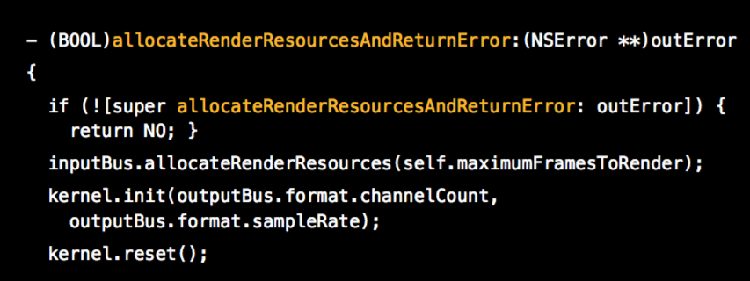
Preparing to Render
First call the base class method
Allocate memory for input bus
Initialize your filter (with channel count, sample rate)

Slide 18
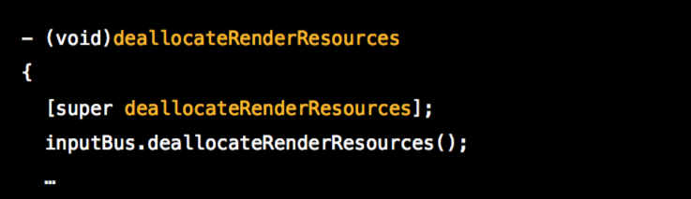
(un)Preparing to Render
Do the same (but opposite) in deallocateRenderResources()

Slide 19
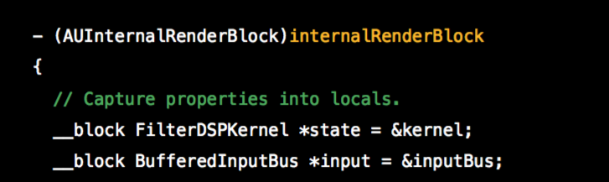
Rendering (Obj-C -> C++)
This gets called at the beginning of every render cycle
Pass C++ members into local variables (__block pointers)
Normally a variable passed into a code completion block does not retain changes in its value
using __block makes these changes persist outside a code completion block
Do NOT use NSObjects, as these suck in real-time – can easily cause audio glitches

Slide 20
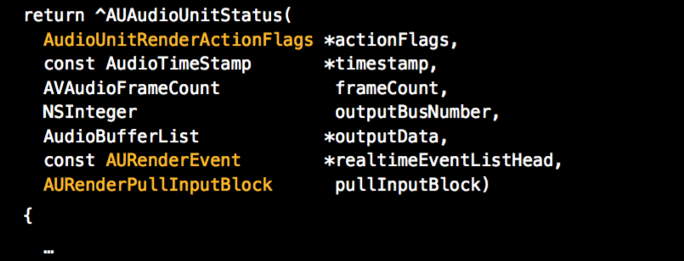
Rendering (cont’d)
We get
timestamp,
frame count,
output buffer list,
real-time event list head
Pull Input block

Slide 21
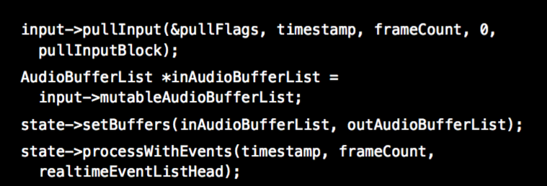
Rendering (cont’d - 2)
AURenderPullInputBlock
This is how host tells us where to get our input from
1) pass the pullInputBlock into our C++ object
2) ask that object to fetch the audio for this render cycle
3) pass in/out buffer lists to your filter’s DSP
4) process your filter for this render cycle
1
2
3
4

Slide 22
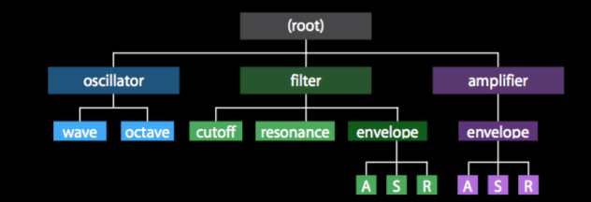
Parameter Trees (reprise)
Parameters can be grouped (here an analog synth)
Groups for oscillator, filter, and amplifier
Bright boxes = parameter layer
All nodes (groups or parameters) have a unique ID
Like a C#
Use simple accessors, e.g.:
filter.envelope.attack or oscillator.wave

Slide 23
Putting it all together
Apple says “Use Objective-C!” as Swift API may change without notice
Can cause conflict between host and appex
Use C++ for your filter code, and __block off pointers to your C++ code inside your Objective-C code
An Xcode template is planned for AU appex
For now, use the example gain project to spawn your appex

Slide 24
Simple Gain App
Major players:
AU v3 Host
Example host application for porting audio units
Represents the “end user experience”
Filter Demo App
“Containing app” for Filter Demo appex
Easier to debug in
Simple Play Engine
Used by FilterDemoApp and AUv3Host for generating a simple audio source to experiment with
Filter Demo Framework
The DSP home for the appex
Filter Demo App Extention
A wrapper to build your filter as an appex

Slide 25
Simple Gain App (cont’d)
FilterDemoAppExtension
FilterDemo
AUAudioUnit
MainInterface
kernel
Framework
AUv3FilterDemo
AUViewController
FilterDSPKernel
DSPKernel
audioUnit
Buffered Audio Bus
Parameter Ramper

Slide 26
FilterDemoApp
Simple Play Engine
MainStoryboard
Appex
FilterDemoAppExtension
FilterDemo
AUAudioUnit
MainInterface
kernel
AUv3FilterDemo
AUViewController
FilterDSPKernel
DSPKernel
audioUnit
Buffered Audio Bus
Parameter Ramper

Slide 27
AUv3Host
Simple Play Engine
MainStoryboard
XPC
Appex
FilterDemoAppExtension
FilterDemo
AUAudioUnit
MainInterface
kernel
AUv3FilterDemo
AUViewController
FilterDSPKernel
DSPKernel
audioUnit
Buffered Audio Bus
Parameter Ramper

